Slide 1
CT071-3-3-DDAC - DESIGNING & DEVELOPING CLOUD APPLICATIONS
Mark Jeremy Essa
TP029006
UC3F1603SE

Slide 2
Table of Contents:
Workload Distribution Table
Project Background
Project Plan
Design
Project Summary

Slide 3
Workload Distribution Table
Task | Description | Estimated Time | Allocation
Investigating | Gather requirements and research project scope | 10 hours | 20%
 | Analyze existing systems and potential solutions
Development | Design and implement software architecture | 20 hours | 40%
 | Write and test code
 | Work on feature development
Deployment | Set up d production environments | 8 hours | 15%
 | Deploy and monitor application

Slide 4
Workload Distribution Table(Cont.)
Task | Description | Estimated Time | Allocation
 | Handle any deployment issues
Documentation | Create user manuals and technical documentation | 12 hours | 25%
 | Document code and APIs
 | Update project documentation as needed
Total Hours |  | 50 hours | 100%

Slide 5
Project Background: Boosting the Growth of Lil-Lucia Cake and Pastries Shop
Problem Statement:
Lil-Lucia Cake Shop, a charming local bakery known for its delectable creations, has reached a point where it seeks to expand its customer base and reach out to newer locations. Despite its reputation for quality products, the bakery is facing challenges in accessing a wider audience and achieving sustained growth. The lack of a growth strategy, limited marketing efforts, and potential operational inefficiencies have hindered the bakery's ability to tap into its full potential.
Objectives:
The central focus of this project is to be able to devise a comprehensive growth strategy for Lil-Lucia Cake Shop that encompasses various aspects to support it’s operations. The project aims to achieve the following objectives:
Online Presence and E-commerce: Establish an online platform for the bakery, including a user-friendly website with an online ordering system. This would enable customers to browse products, place orders, and Lil Lucia could then handle the delivery of the products.

Slide 6
Objectives(Cont.):
Operational Efficiency: With the establishing of the online shop, this would streamline internal processes to optimize production, reduce wastage, and improve cost-effectiveness. This could involve inventory management systems in the future, production scheduling, and staff training.
Partnerships and Collaborations: With the online shop being established the fact that the bakery could also explore potential partnerships with other cafes, as well as also venturing into working with catering companies in the sense of preparing the deserts in the future to expand the bakery's reach and customer base. Collaborations can lead to cross-promotion and shared marketing efforts especially with the online shop.

Slide 7
Project Plan
Phase 1: Project Setup and Front-End Development
Week 1-2: Project Kickoff and Planning
Define project scope, requirements, and features.
Plan development milestones and timeline.
Set up GitHub repository for version control.
Week 3-4: Front-End Development
Create React application structure.
Develop UI components and layouts.
Implement routing and navigation.
Week 5-6: Front-End Integration
Connect front-end to mock API endpoints.
Implement user authentication and authorization.
Test UI responsiveness and compatibility.
Phase 2: Back-End Development and Database Setup
Week 7-8: Back-End Setup
Set up Node.js environment.
Create Express.js application.
Implement basic API routes for data retrieval.

Slide 8
Week 9-10: MySQL Database Setup
Set up AWS RDS instance for MySQL.
Design database schema based on application requirements.
Implement data models and relationships.
Week 11-12: Back-End Development
Develop API routes for CRUD operations.
Implement server-side validation and error handling.
Integrate authentication and authorization with front-end.
Phase 3: Deployment and Testing
Week 13-14: AWS Infrastructure Setup
Set up AWS EC2 instance for the Node.js application.
Configure security groups and networking.
Deploy the backend application on the EC2 instance.
Week 15-16: Database Deployment and Data Migration
Configure AWS RDS security groups and access.
Migrate data from local development database to RDS.
Update application configuration to use RDS.

Slide 9
Week 17-18: Testing and Quality Assurance
Perform unit testing for front-end and back-end components.
Conduct integration testing for end-to-end functionality.
Phase 4: Finalization and Deployment
Week 19-20: Performance Optimization and Finalization
Implement caching mechanisms where applicable.
Fine-tune database indexes and queries.
Week 21-23: Final Testing and Deployment
Conduct user acceptance testing.
Perform load testing to ensure application scalability.
Deploy the complete application on AWS Cloud (back-end).

Slide 10
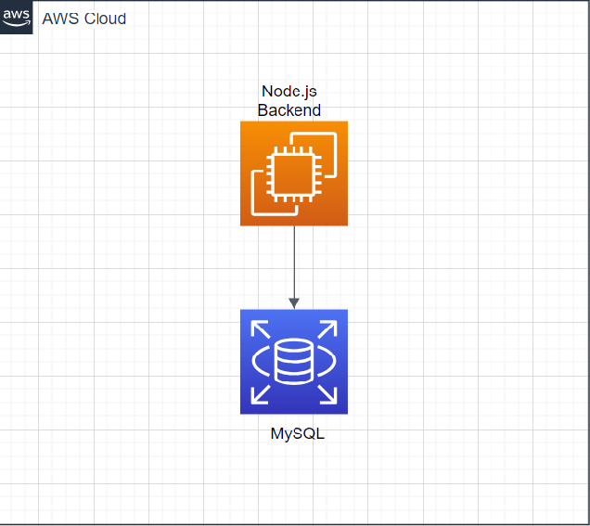
Design
Cloud Architectural Diagram - Two-Tier Architecture with EC2 and RDS:

Slide 11
Reasoning:
A simplified Two-Tier Architecture with EC2 instances for the backend and AWS RDS for the database can provide an efficient solution. This approach allows for the separation of the application logic and data storage, enabling easier management and scaling of both layers.
EC2 Instances (Backend): Hosts the Node.js backend application, handling API requests, business logic, and application functionalities.
Node.js Application: Contains the backend logic, including API endpoints, user management, and recipe handling.
MySQL Database (AWS RDS): Stores application data, such as user profiles, products, and related information, providing reliable and scalable data storage.

Slide 12
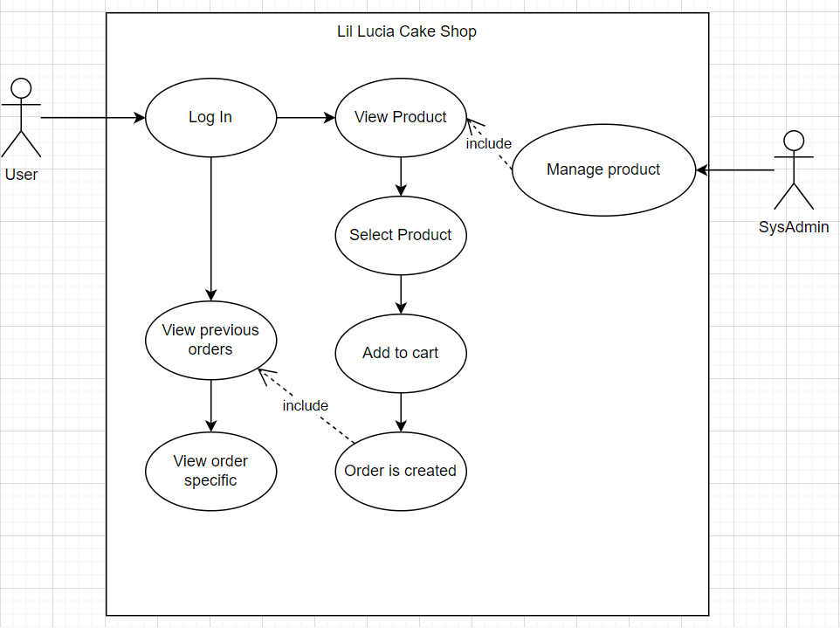
Use case diagram

Slide 13
Cloud Services Used
AWS RDS
AWS EC2
Project Summary:
We propose the development of a cloud-based online cake web application that enables users to discover, manage, and purchase their favourite cakes. Leveraging modern technologies and cloud architecture, the application aims to provide a seamless user experience while ensuring scalability, security, and accessibility when the need arises.
Cloud Architecture: Two-Tier Architecture with EC2 and AWS RDS:
A simplified Two-Tier Architecture is adopted, utilizing EC2 instances for the backend and AWS RDS for the database. This separation of logic and data storage allows for efficient management, scalability, and security.

Slide 14
Project Summary (Cont.)
The cloud-based online cake web application aims to deliver an engaging and user-friendly platform for people to purchase the cakes or pastries that they are interested in and with that enable Lil-Lucia to then grow in terms of business. Through careful architectural choices and user-centric design, the project is poised to offer a valuable and enjoyable experience to users while ensuring operational efficiency and scalability.

